Slide 1
Introduction to JSX

Slide 2
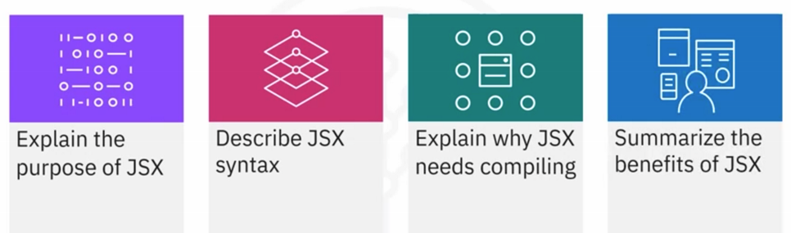
What you will learn

Slide 3

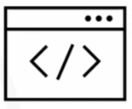
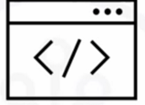



Purpose
Also supports JavaScript
expressions
Looks like HTML

Slide 4
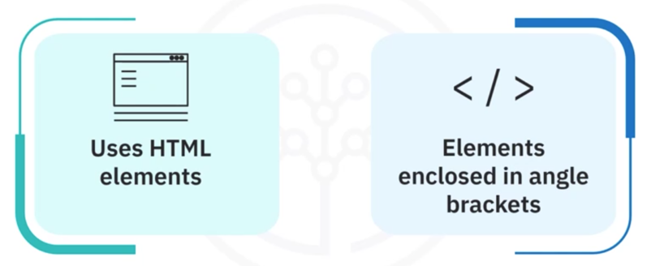
Syntax

Slide 5


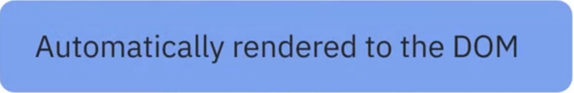
Sample Code

Slide 6
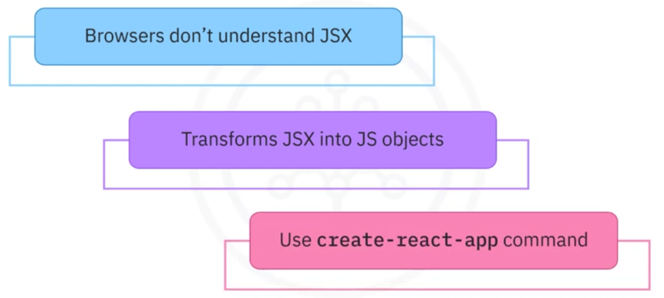
Compiling

Slide 7
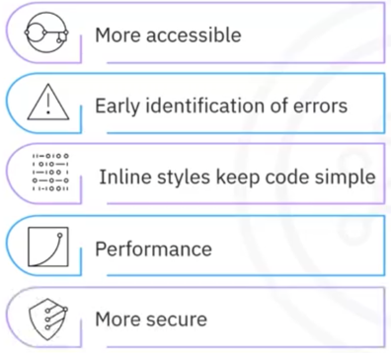

Benefits of JSX

Slide 8
Recap
In this video, you learned that:
• JSX reads similarly to HTML
• JSX uses HTML elements combined with JavaScript expressions
• JSX relies on compilers to transform HTML-like text into standard
JavaScript objects
• The benefits of using JSX include:
• Easily readable code
• Error identification
• Improved performance
• Added security

